Slide 1
House Renting Service
Steven Yang
Davinder Sandhu
Gagandeep Singh

Slide 2
Topics
Motivation
Introduction
Project Phases
Information Flow Diagram
User Interface
API Use
API Description
Web Scraping
Project Scope
Challenges
Future Scope

Slide 3
Motivation
No current single website with all integrated options like nearby places, safety factors, nearby Facebook friends
User can give priority to renting place based on his needs and interest like nearby grocery stores, club ,bars etc.
Fun, Safe, and Cost Efficient

Slide 4
Introduction
Goal: House renting process easier with necessary detail on single page
Implementation: asp.net, C# , SQL, JavaScript, HTML, MVC
Target user-base: People looking for renting house based on some preferences
Data: Data dynamically from different API’s like Yelp API, Google maps etc.

Slide 5
Project Phases
Parsing
Querying
Integrating Data

Slide 6
Parsing
Search refinement options like nearby places
Neighborhood safety factors
Keywords like place name and zip code can be used

Slide 7
Querying
Query is based on user’s option selection like area of interest, nearby places etc.
uses zip code and address
Query is passed to different API’s by creating a Form

Slide 8
Data Integration
Data from Yelp API, Zillow API etc. is in XML document form
Uses Xml query to obtain related information
Passing location tags to google map

Slide 9
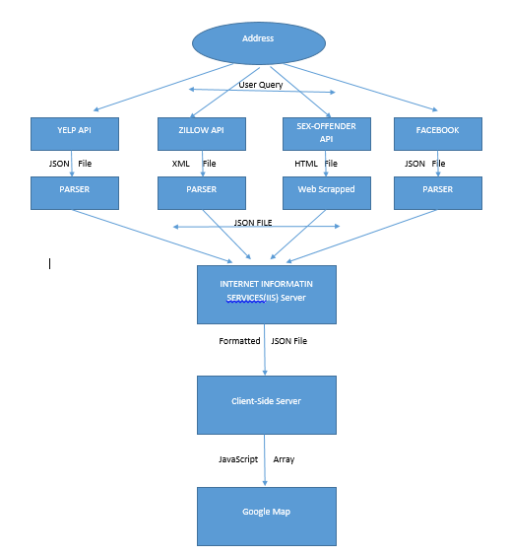
Information Flow Diagram

Slide 10
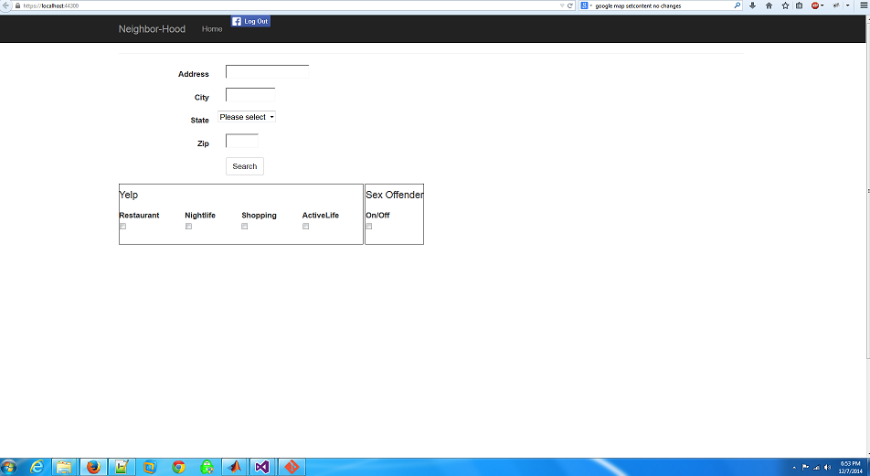
User Interface
Home page

Slide 11
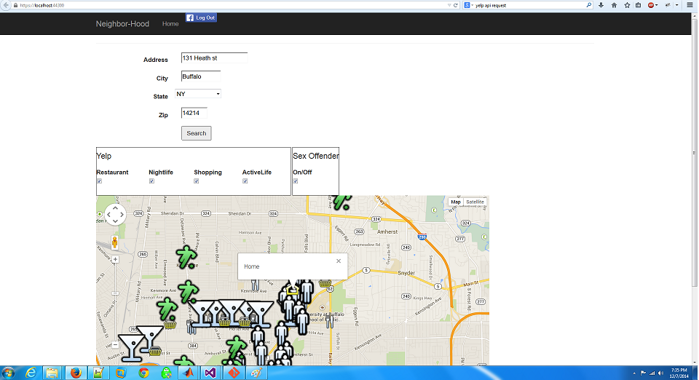
Query result

Slide 12
API Used
Yelp API
Zillow API
Google API
Facebook API

Slide 13
API Description
Yelp API
By using the Yelp API we were able to:
Find up to 20 best results for a geographically-oriented search
Sort results by the best match for the query, highest ratings, or distance
Limit results to those businesses offering a Yelp Deal, and display information about the deal like the title, savings, and purchase URL
Identify and display whether a business has been claimed on Yelp.com

Slide 14
API Description
Zillow API
The new Zillow API Network turns member sites into mini real estate portals by offering fresh and provocative real estate content.
Home Valuation
Search results list, Zestimate®, Rent Zestimate®, home evaluations, home valuation charts, comparable houses, and market trend charts.
API calls of interest:
GetSearchResults

Slide 15
API Description
Google Map API
The Google Map API JavaScript V3 allows you to pass in place information to display on a map.
Google Geo API
The API allows you to get longitude and latitude with a address.

Slide 16
Web Scraping
Web Site:
Search by URL with Zip Code parameter
Scrape all results for the criminals
Make request to each person
Scrape require information i.e.. Address and Name

Slide 17
Scope Of Project
User Specific Search
One Stop Shop
Safety Factors

Slide 18
Challenges
Number of API’s request
No Paid API’s services
Web Scraping(Solution)
Keyword Typos
No Full Access to Facebook API due to lack of Privacy Documentation

Slide 19
Future Scope
Mobile application
Direct booking service
Public transportation services availability
Search refinement based on cost factor
Facebook Privacy Document to access Friend’s Check-in locations
Auto complete on address input

Slide 20
Thank You

Slide 21
Questions?

